Slide 1

INTRODUCTION TO CANVA

Slide 2
INTRODUCTION
Canva is a free online graphic design platform that can be used to create a variety of visual content, including social media graphics, presentations, posters, and more. It's a great tool for anyone who wants to create professional-looking content without having to learn how to use complex design software.
The image you sent shows a diagram of the different types of content that can be created with Canva. As you can see, there are a wide variety of options, so you're sure to find something that's right for your needs.

Slide 3
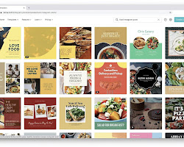
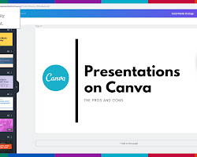
Social media graphics: Canva has a library of templates that you can use to create eye-catching social media graphics for your business or personal brand.
Presentations: Canva makes it easy to create professional-looking presentations that will engage your audience.

Slide 4

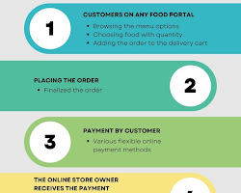
Posters: Canva has a variety of templates that you can use to create posters for events, parties, or marketing campaigns.
Infographics: Infographics are a great way to present complex information in a visually appealing way. Canva has a library of templates that you can use to create infographics, or you can start from scratch.

Slide 5
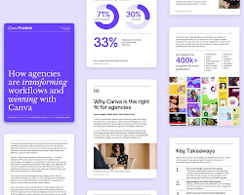
Whitepapers: Whitepapers are a great way to share your expertise with your audience. Canva makes it easy to create whitepapers that are visually appealing and easy to read.

Slide 6
1. Social Media Graphics:
Facebook Post: 940 x 788 pixels
Instagram Post: 1080 x 1080 pixels
Twitter Post: 1024 x 512 pixels
LinkedIn Post: 1200 x 627 pixels
Pinterest Pin: 1000 x 1500 pixels
YouTube Thumbnail: 1280 x 720 pixels
2. Blog Graphics:
Blog Graphic: 800 x 1200 pixels
3. Presentation Slides:
Standard PowerPoint Slide: 1024 x 768 pixels
Widescreen PowerPoint Slide: 1920 x 1080 pixels
4. Print Materials:
Letterhead: 2550 x 3300 pixels
Business Card: 1080 x 608 pixels
Flyer: 1100 x 850 pixels
Poster: 720 x 1080 pixels
5. Digital Marketing:
Email Header: 600 x 200 pixels
eBook Cover: 1410 x 2250 pixels
Facebook Cover: 1640 x 720 pixels
Twitter Header: 1500 x 500 pixels
YouTube Channel Art: 2560 x 1440 pixels
Canva for Work subscribers have access to the "Magic Resize" feature, which allows them to quickly adapt their designs to multiple sizes with a single click.

